Slide 1

Ascension
Pope Benedict XVI helps us to
understand the meaning of the Ascension
Reference
I Believe in One God, pp. 127 & 129, Pope Benedict XVI)
Illustrations copyright © Teachers’ Enterprise in Religious Education Co. Ltd.

Slide 2
What happens when someone dies?
We know that when someone dies they leave this life. They go on to live another life.
If they have believed in Jesus then they go to heaven.
Jesus wants us to understand that it is different for him.

Slide 3
Before Jesus went back to his Father in heaven, he explained to the Apostles what would happen.
Jesus said: “I go away, and I will come to you.” It is by going away that he comes. His going brings about a completely new and greater way of being present.

Slide 4
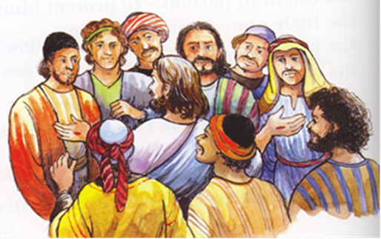
Jesus’ Farewell
“Do not let your hearts be troubled or afraid.
You heard me say:
I am going away, and shall return.”
(Jn. 14:28)

Slide 5

Pope Benedict explains what Jesus meant.
By going away, Jesus brings about a completely new and greater way of being present.
When Jesus died he entered into the love of the Father. His dying was an act of love. Love is immortal – it never dies.

Slide 6
In the Sacrament of Baptism, Jesus enters our life through the door of our heart.
The Risen Jesus comes and joins our life to his life and draws us into his very great love.
It is as if we are born again into the life of God through baptism.

